Slide 1
Website for Painxthriller
-Anthony Inzunza

Slide 2
Creating Nav bar
Beginning of every website starts with the nav bar.
Here is the start of my nav bar in the HTML file.
I used random text as a place holder to fill in later.

Slide 3
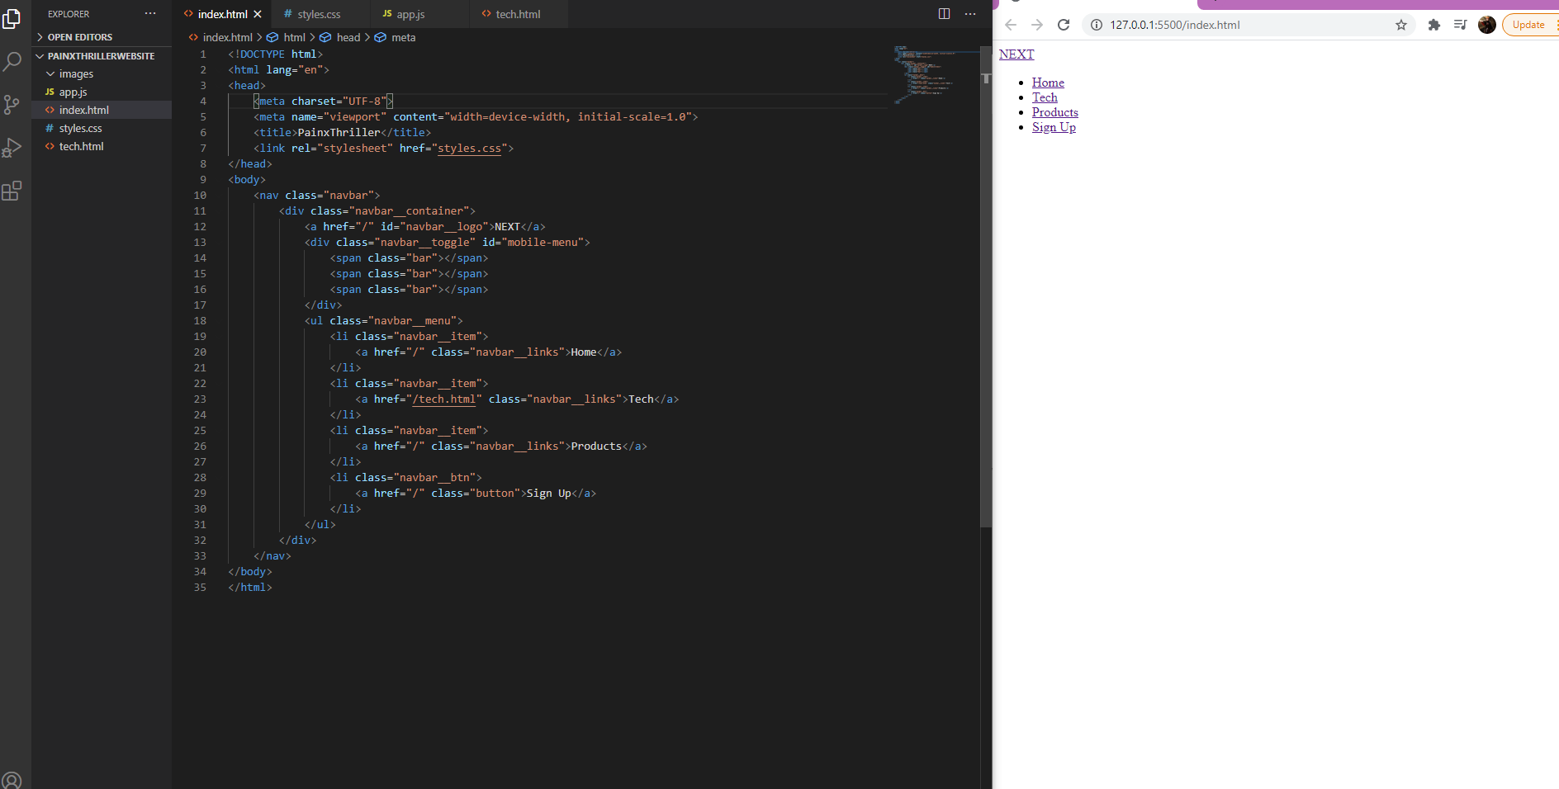

Slide 4
Nav bar
After creating the text and the links for the nav bar, I edited the nav bar in the CSS page
In the picture you can see the exact colors
You can also see how I formatted the text to fit on the page.
Used webkit for the first time, which the background-clip CSS property sets whether an element's background extends underneath its border box, padding box, or content box.

Slide 5
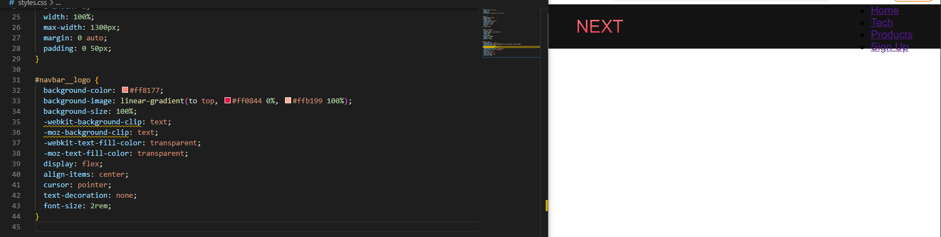

Slide 6
Nav bar cont.
Next thing to format was the navbar links.
In the next picture you will see the color I used
Used the flex property to keep items the same length
Used justify-content to align items in the center

Slide 7
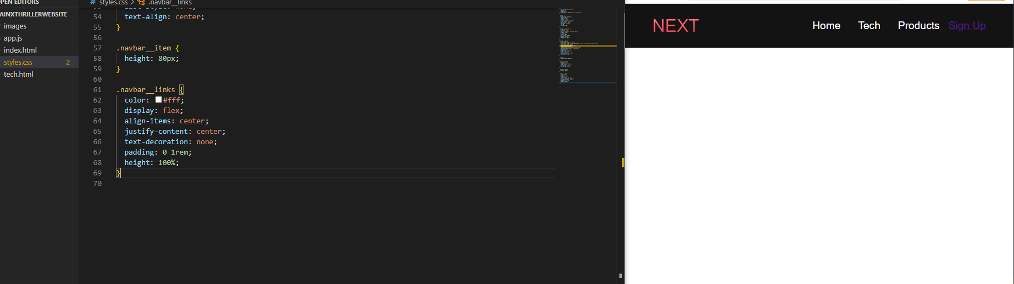

Slide 8
Nav bar cont.
Next was setting up the buttons on the page, I used this method for most of the buttons on the website.
I had to align everything, using width, height, padding, border, outline, border-radius, and the colors for background and the text.

Slide 9
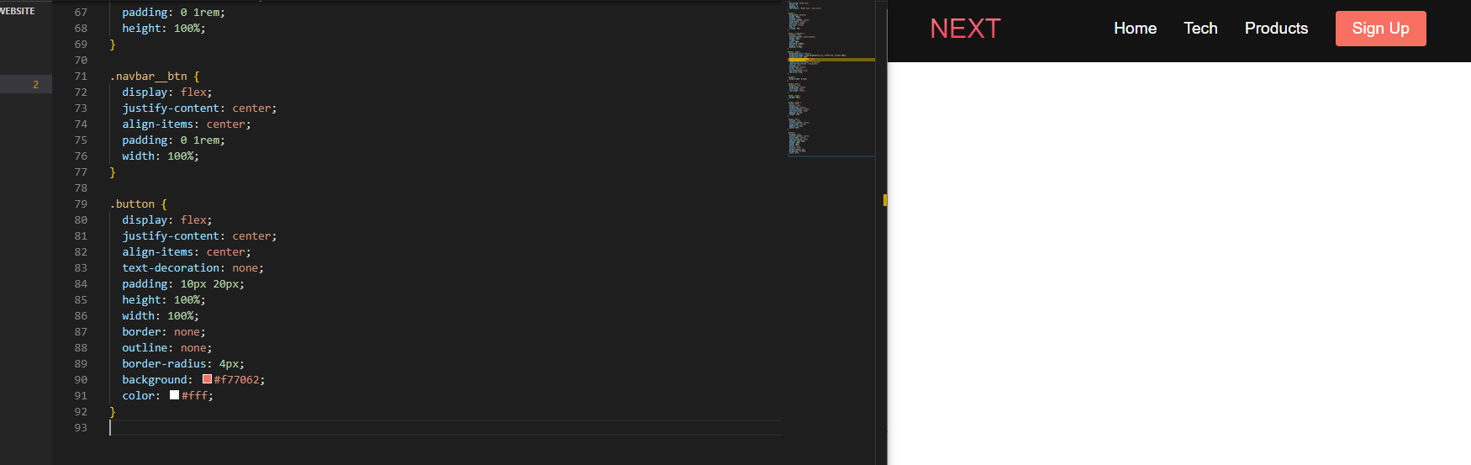

Slide 10
@media
Once I was finished with formatting, I had to make it work on different sizes of screen.
I used the @media rule to make sure it works on various screen sizes.

Slide 11
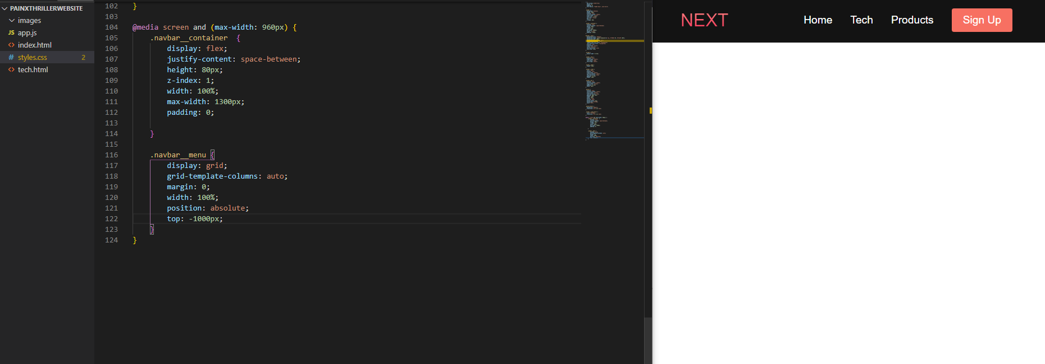
Hide nav bar on smaller screens

Slide 12
Dropdown menu
This brings me to the drop down menu
Used the @media to create the drop down bar once the screen size hit a certain size

Slide 13
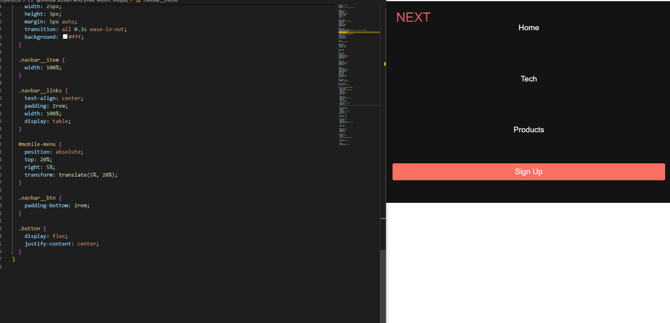

Slide 14
Main content section
Next I worked on the main content section
Here is where I added an image and slogan to catch the attention of the user
To edit in the css I had to recall every heading to design the text and image.

Slide 15
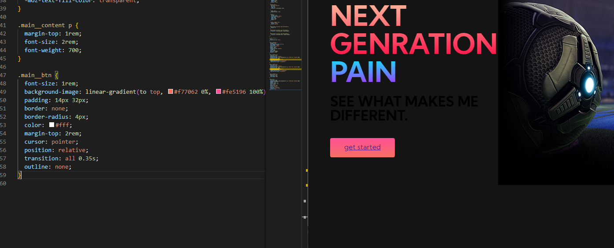

Slide 16
Image cards
Other items I added to my website was image cards to get the user to another page of my website.
With this I had to use the nth child property in the CSS to edit the text and cards.
Again I had to recall to every header or <p> that I used.

Slide 17
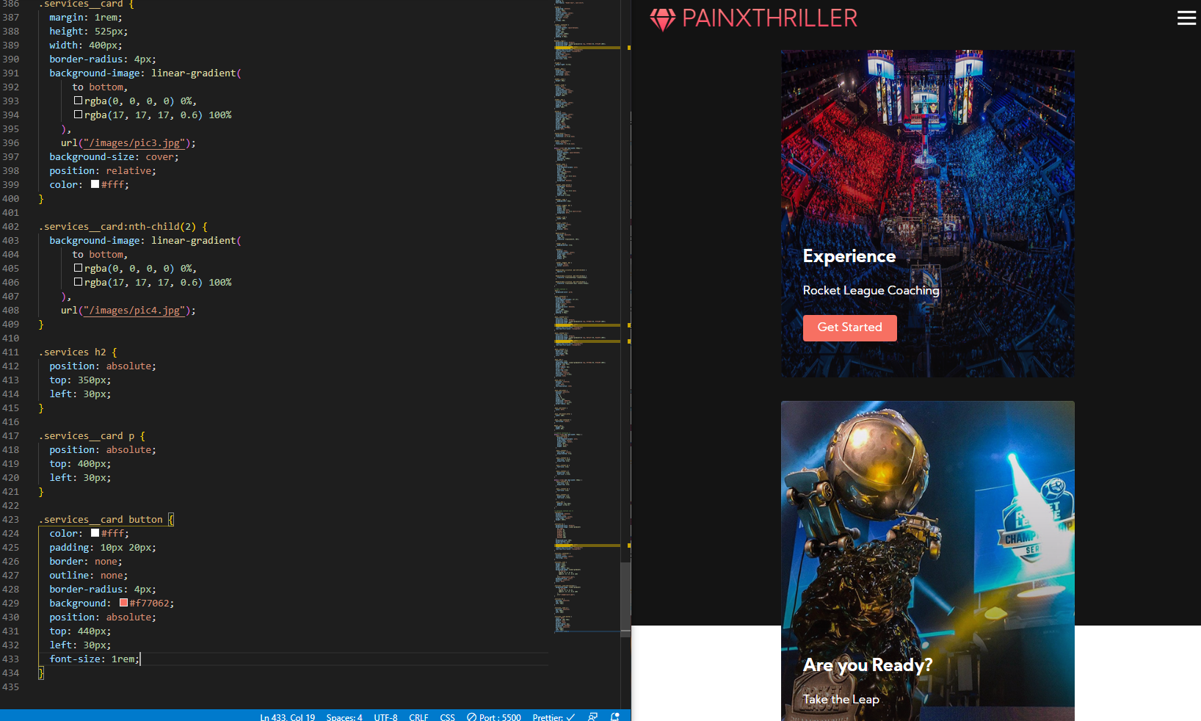

Slide 18
footer
The footer was the easiest part.
I added links to other parts of my page and my social media.

Slide 19
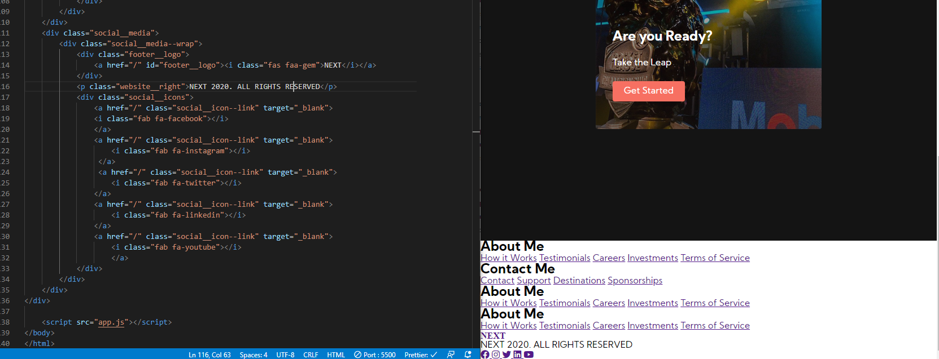

Slide 20
Next page
In the next page I copied over the index page to another html file.
I changed a few things in the page to flow with the theme of the page
I changed where the button leads to.

Slide 21
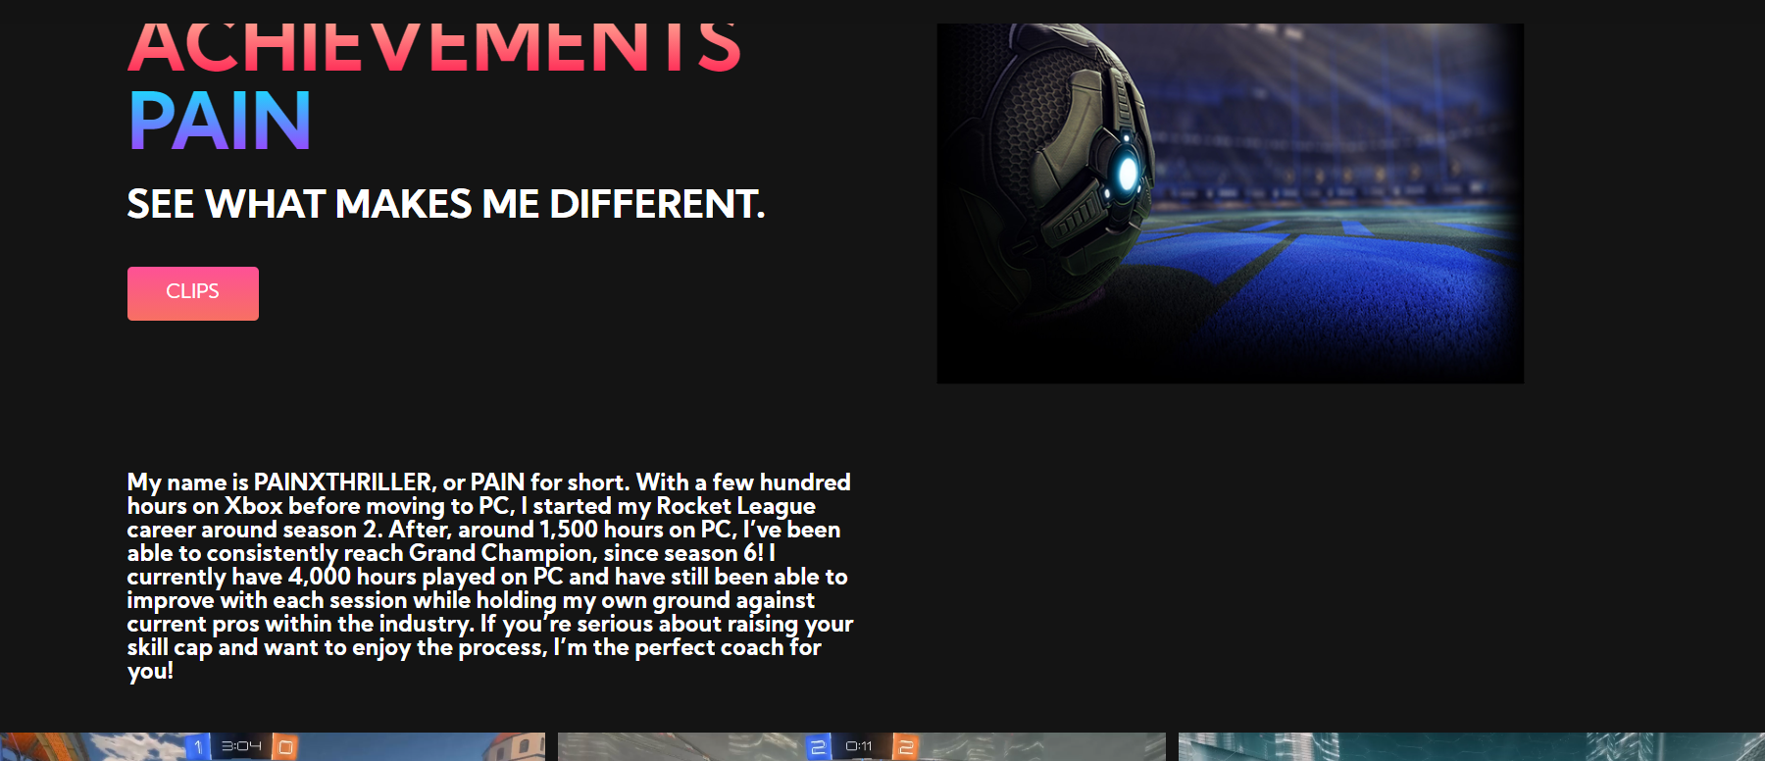

Slide 22
Tech page cont.
I added a gallery to show off my clips and achievements here is the example.
In the css I used the same techniques to format, color and size the images and text

Slide 23
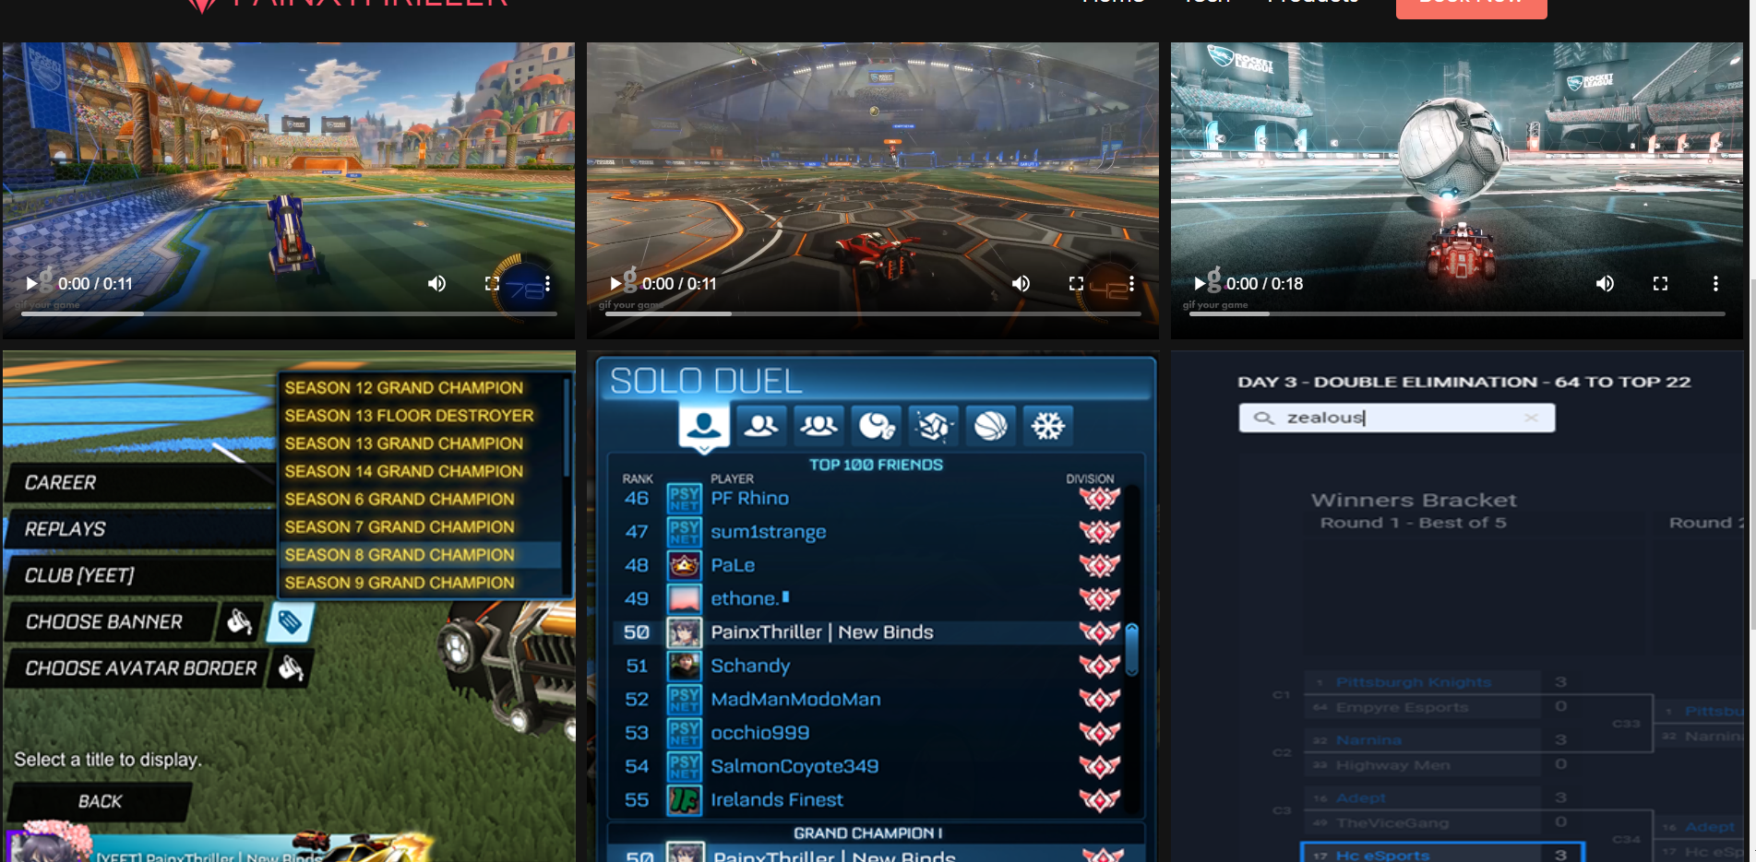

Slide 24
Review page
In the review page I copied over the index page to another html file.
This page focused on my coaching content and reviews.
I used the same techniques as the other pages to position, align and format the images and text.

Slide 25


Slide 26
